Slide 1
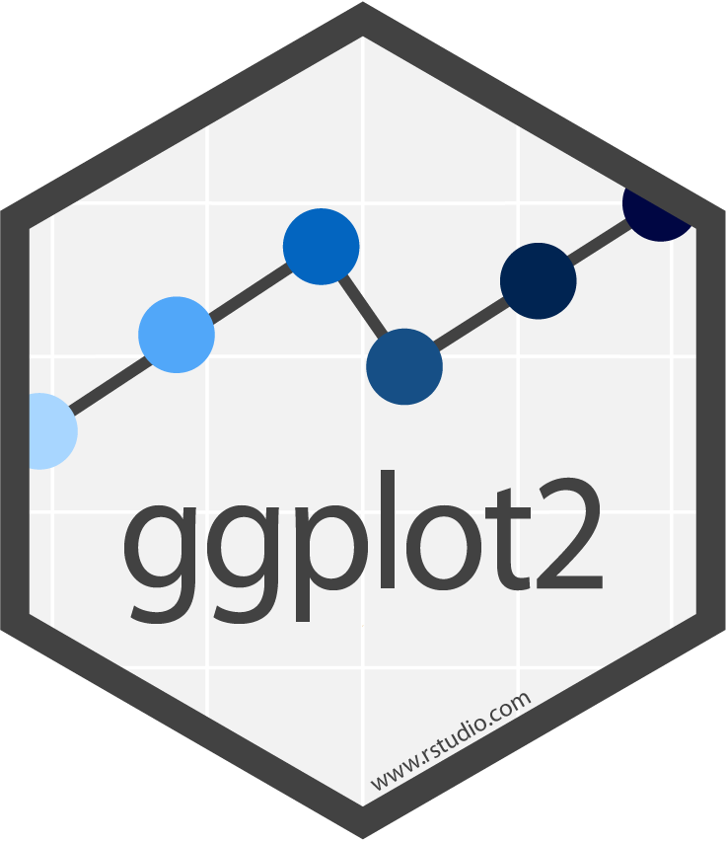
DATA VISUALIZATION WITH ggplot2
25 Giugno 2019
library(dplyr)
rladies_global %>%
filter(city == 'Bari')

Slide 2
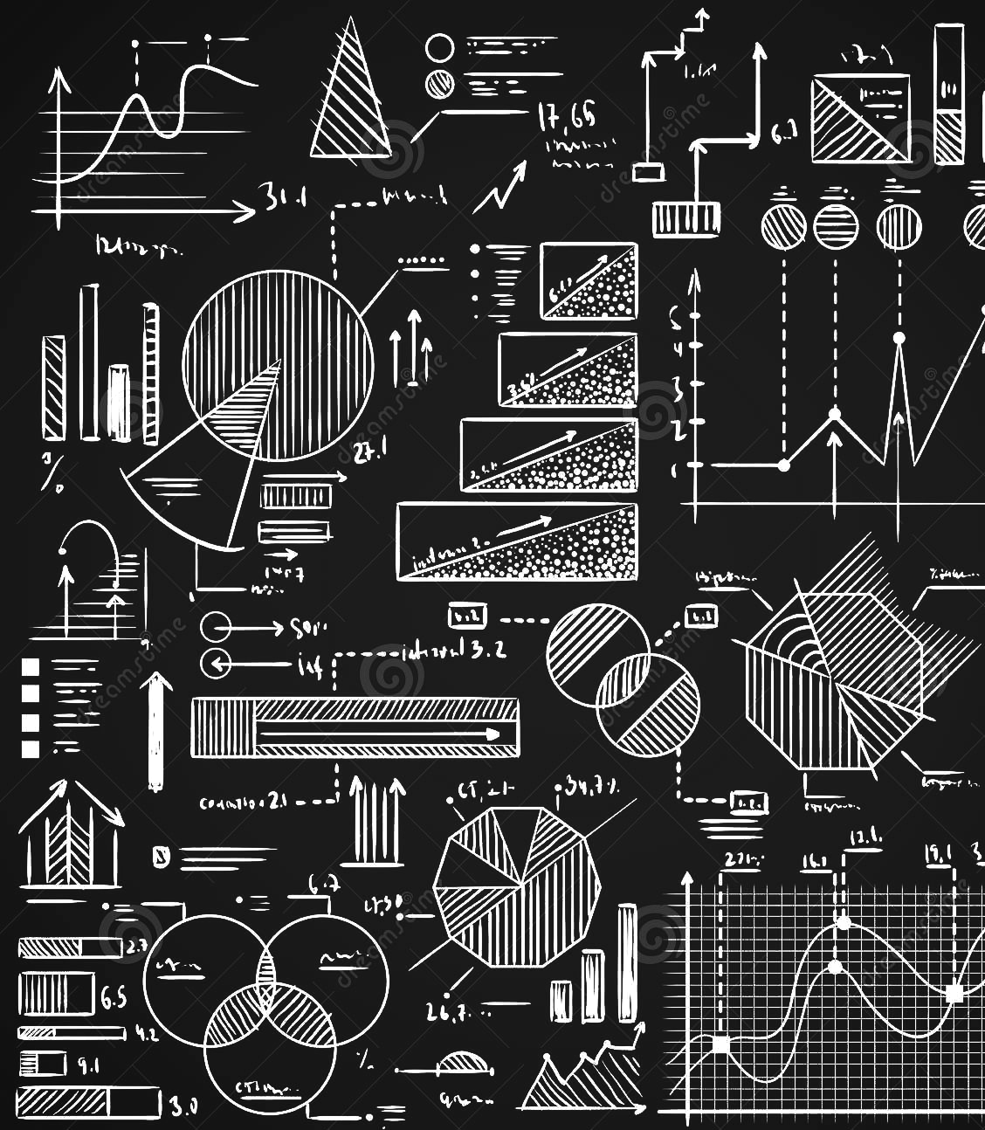
What is ggplot2?
is part of the larger family of R packages for doing data science
in R : the tidyverse packages.
focuses on data visualization
is powerful and flexible
Notes:
Is powerful and flexible perchè permette di di crare tanto grafici semplici quanto visualizzazioni estremanente complesse

Slide 3
Why ggplot2?
consistent underlying grammar of graphics (Wilkinson, 2005)
plot specification at a high level of abstraction
theme system for polishing plot appearance
mature and complete graphics system

Slide 4

What is the Grammar Of Graphics?
data
aesthetic mapping
geometric object
statistical transformations
scales
coordinate system
position adjustments
faceting
Basic idea:
independently specify plot building blocks and combine them
to create just about any kind of graphical display you want.
Building blocks of a graph include:
Notes:
I won’t explain the Grammar of Graphics here, but understand that it enables a data scientist to think about data visualization in a highly structured way. Moreover, because the syntax of ggplot2 is based on the Grammar of Graphics, it makes it possible to create data visualizations with a relatively concise syntax, whether they are simple visualizations or and complex visualizations .
Data: The data-set being plotted
Aesthetics: The scales onto which we plot our data
Geometry: The visual elements used for our data
Facet:Groups by which we divide the data
A grammar of graphics is a tool that enables us to concisely describe the components of a graphic. Such a grammar allows us to move beyond named graphics (e.g., the “scatterplot”) and gain insight into the deep structure that underlies statistical graphics. This article builds on Wilkinson, Anand, and Grossman (2005), describing extensions and refinements developed while building an open source implementation of the grammar of graphics for R, ggplot2.

Slide 5
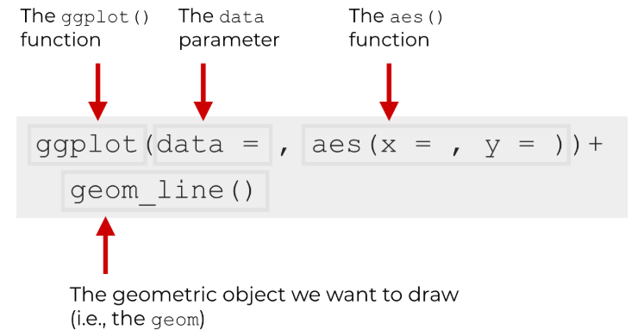
The Syntax of ggplot2
The great thing about the syntax of ggplot2 is that its highly systematic.
The structured nature of ggplot2 makes it very powerful, once you understand it:
starting with a layer showing the raw data
then adding layers of annotation and statistical summaries.
The Basics
Notes:
Once you understand how the system works, it makes a lot of sense, but you might need to do some work to understand it first.
That being said, let’s take a careful look at the syntax.

Slide 6
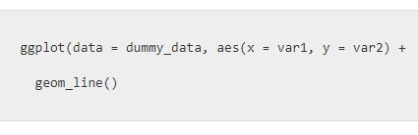
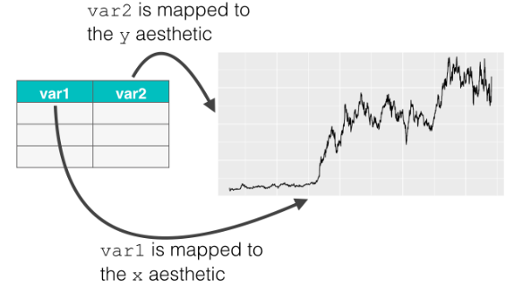
The ggplot() Function
core function of ggplot2: it initiates plotting.
main parameter of the ggplot() function
data= specifies the data.frame object that contains the data that you want to visualize
aes() function creates a mapping from the underlying data to visual objects that get drawn (the geoms).
Keep in mind that ggplot2 geoms have lots of aesthetic attributes that you can manipulate:
x-position,
y-position,
color,
size,
shape,
and more.
Notes:
any time you want to create a data visualization with ggplot2, you’re going to use this function.
almost everything else in the ggplot2 system is built “on top of” this function.
Data parameter: The ggplot2 system works almost exclusively with data.frame objects. So when you provide an argument to the data parameter, it will always be a data.frame object of some type (i.e., a a traditional data.frame or a tibble).
Aes function: way to “connect” the dataset to the geoms that get drawn. It enables you to create a set of “mappings” from your dataset to the geoms in your data visualization. More precisely, the aes() function allows you to map the variables in your data frame to the aesthetic attributes of the geometric objects of your plot.
data visualizations are essentially visual representations of an underlying dataset. For the data visualization process to work properly, there needs to be a connection between the data (the dataframe) and the visual objects that we draw (the geoms).
Esempio: Take a look at the code and then look at the image. Inside of the aes() function, we have the code x = var1 and y = var2. Here, x refers to the x position aesthetic. Similarly, y refers to the y position aesthetic. These are aesthetic attributes of the points on the line that we’re drawing. And ultimately, by using the aes() function this way, we’re connecting the parts of the line to the underlying data in the dataset, dummy_data.
Keep in mind that ggplot2 geoms have lots of aesthetic attributes that you can manipulate: x-position, y-position, color, size, shape, and more.
Also, keep in mind that different geoms (lines, points, bars, etc) have different aesthetic attributes that you can manipulate.
Some aesthetics are relatively universal (like x-position) but others are specific to specific geoms.
Regardless, to get the full power out of the ggplot2 system, you need to have a firm understanding of how to create variable mappings using the aes() function.

Slide 7
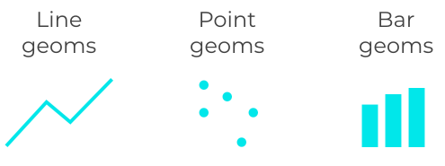

The geom_() Function
“geoms” are the geometric objects of a data visualization. They are the things that get drawn in a data visualization.
a plot must have at least one geom; there is no upper limit. You can add a geom to a plot using the + operator
main attribute of the ggplot() function:
position (i.e., on the x and y axes)
color (“outside” color)
fill (“inside” color)
shape (of points)
linetype
size
list of available geometric objects:
Notes:
So there’s a dataset that you will plot, and then there’s the visual output itself, which is determined by your geom specification.
the type of geom or geoms that you use determine the type of data visualization that gets created.
And remember, geoms are the visual things that we draw in a plot. Therefore, any geom that you draw has attributes.
Geoms are the actual marks we put on a plot

Slide 8
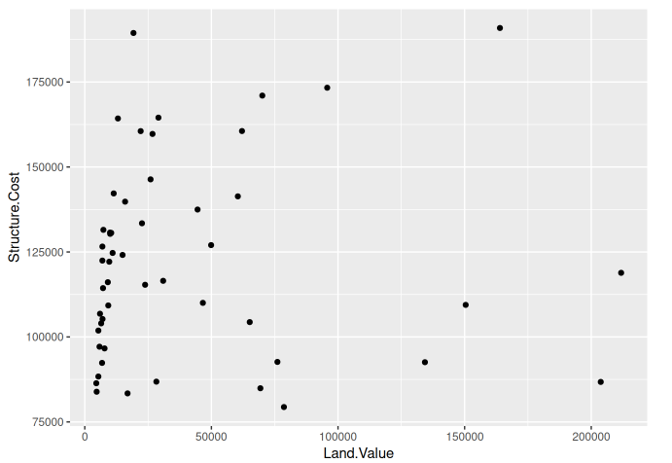

Main geom_() Function
Points (Scatterplot)

Slide 9
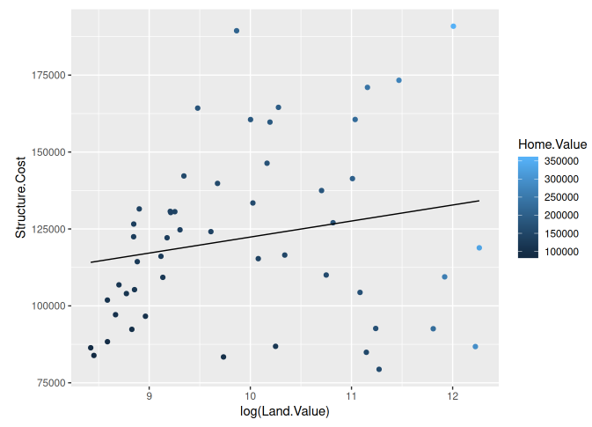
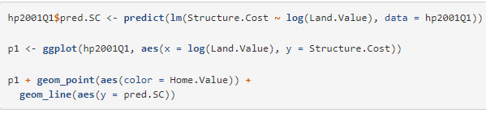
Main geom_() Function
Lines (Prediction Lines)

Slide 10
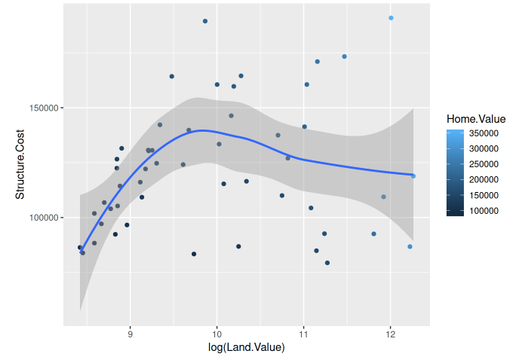

Main geom_() Function
Smoothers

Slide 11
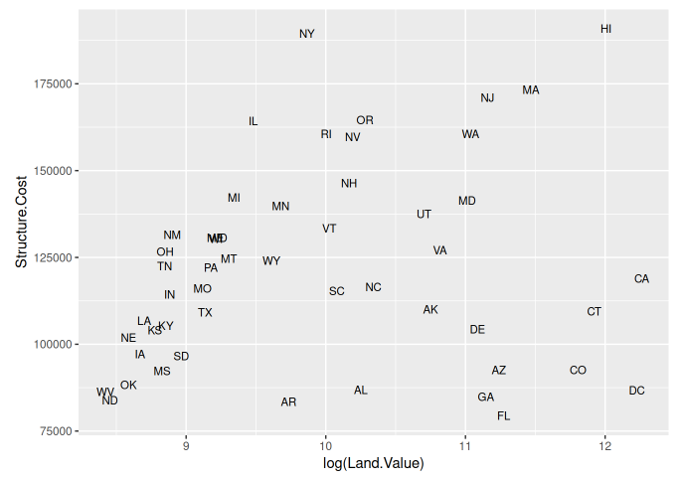

Main geom_() Function
Text

Slide 12
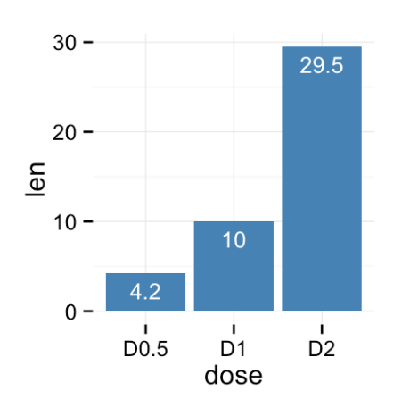

Main geom_() Function
Bar
!
theme_() function
theme system handles non-data plot elements such as
Axis labels
Plot background
Facet label background
Legend appearance
Specific theme elements can be overridden using theme() and specifying parameter to modify

Slide 13
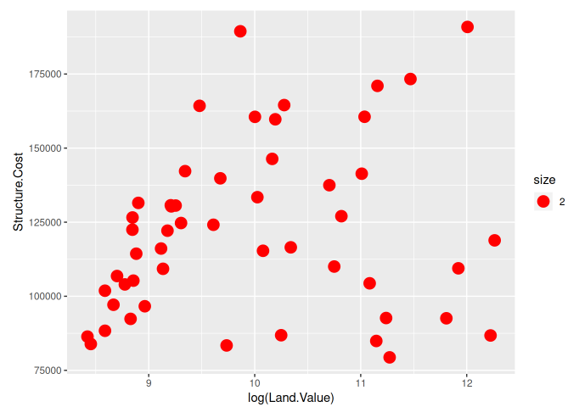

Aesthetic Mapping VS Assignment
Note that variables are mapped to aesthetics with the aes() function, while fixed aesthetics are set outside the aes() call.
!
if aes() influences all geom_() object we define them at ggplot() function levels,
else we have to specify them in the specific geom_() function

Slide 14
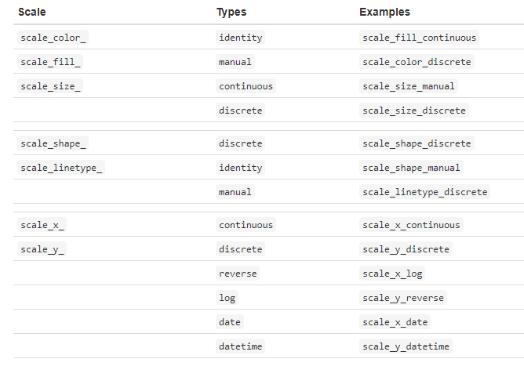
Scales
Controlling Aesthetic Mapping: aes() only says that a variable should be mapped to an aesthetic. It doesn’t say how that should happen.
Describing what colors/shapes/sizes etc. to use is done by modifying the corresponding scale. In ggplot2 scales include
position
color and fill
size
shape
line type
Scales are modified with a series of functions using a scale_<aesthetic>_<type> naming scheme.
Try typing scale_<tab> to see a list of scale modification functions.
Notes:
For example, when mapping a variable to shape with aes(shape = x) you don’t say what shapes should be used. Similarly, aes(color = z) doesn’t say what colors should be used.
The following arguments are common to most scales in ggplot2:
name: the first argument gives the axis or legend title
limits: the minimum and maximum of the scale
breaks: the points along the scale where labels should appear
labels: the labels that appear at each break
Specific scale functions may have additional arguments; for example, the scale_color_continuous function has arguments lowand high for setting the colors at the low and high end of the scale.

Slide 15
Coordinate System
Coordinate systems are specified with functions that all start with coord_() and are added as a layer. There are a number of different possible coordinate systems to use, including:
coord_cartesian() the default cartesian coordinate system, where you specify x and y values (e.g. allows you to zoom in or out).
coord_flip() a cartesian system with the x and y flipped
coord_fixed() a cartesian system with a “fixed” aspect ratio (e.g., 1.78 for a “widescreen” plot)
coord_polar() a plot using polar coordinates
coord_quickmap() a coordinate system that approximates a good aspect ratio for maps. See documentation for more details.

Slide 16
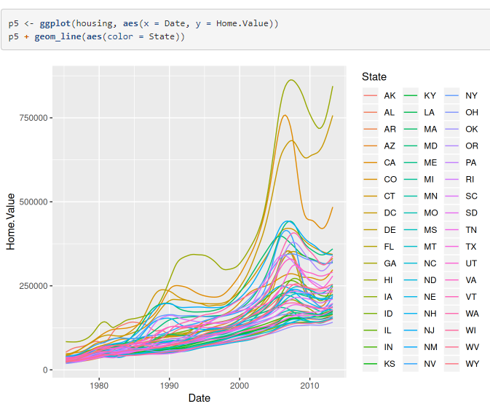
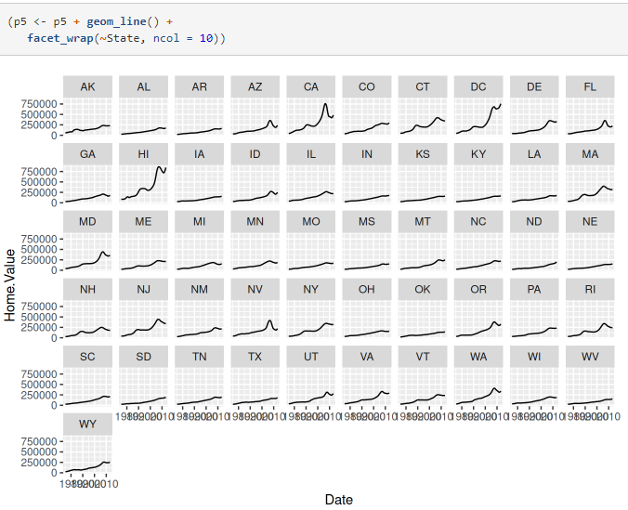
Faceting
The idea is to create separate graphs for subsets of data.
ggplot2 offers two functions for creating small multiples:
facet_wrap(): define subsets as the levels of a single grouping variable
facet_grid(): define subsets as the crossing of two grouping variables
Facilitates comparison among plots, not just of geoms within a plot

Slide 17


